Slide 1
EXTREMOPHILES: Thermophiles & Acidophiles

Slide 2
EXTREMOPHILES
Organisms found living in extreme harsh environments.
Word originated from Greek- Extremus ₊ Philia which
means extreme loving
Definition: Extremophiles are organisms that have been discovered on earth that survive in environments that were once thought not to be able to sustain life.
Most members of this group comes under the domain Archae.
These include thermophiles, hyperthermophiles, thermoacidophiles, alkaliphiles, psychrophiles, halophiles, barophiles, radiation resistant bacteria and endoliths.

Slide 3
Adaptations
Extremozymes- specialized enzymes that are highly stable.
Can tolerate extremes of temperature, pH, salinity that would inactivate other enzymes.
Important in industries because of this property.

Slide 4
EXTREME CONDITIONS
Temperature
pH
Salinity
Nutritional scarcities
Absence of oxygen
Radiation
Pressure

Slide 5
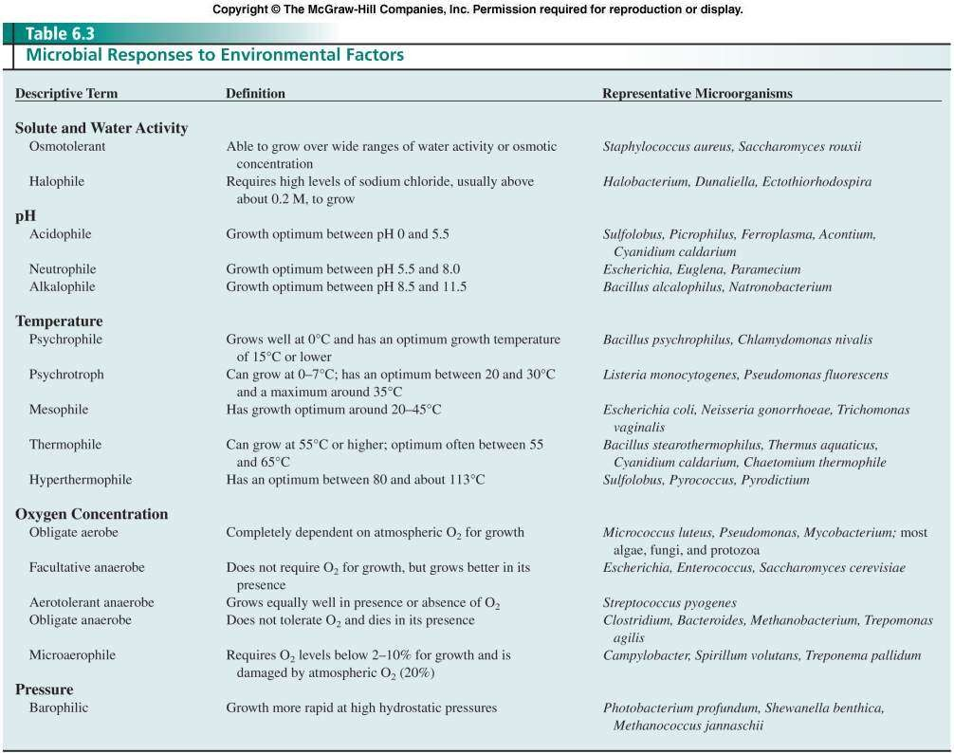
Response to Environmental factors

Slide 6
TYPES
Psychrophiles
Temperatue range is -15 to 15⁰C
Also known as cryophiles.
Have an optimum temperature of 15⁰C or lower
Isolated from Arctic and Antarctic habitats (90% of the ocean is 5⁰C or colder)
Also found in ice bergs, glaciers, snowfields etc
Metabolism is quite normal at colder temperatures.
Cell membranes-high levels of fatty acids which remain fluid at colder temperatures.
Proteinaceous antifreeze mechanism to protect the cell and DNA
Some of them cause spoilage in refrigerated food materials.
Eg: Arthrobacter spp, Psychrobacter spp, Halomonas spp, Pseudomonas, Sphingomonas

Slide 7
FIRMICUTES
Gram positive, spore forming bacterial family that can survive desiccation and can survive extreme conditions.
This group also is an example for extremophilic true bacteria (eubacteria).
Plays an important role in the spoilage of beer, wine and cider.
Eg: Helicobacterium spp, Mycoplasma, Clostridium spp.

Slide 8
Many members of the Family Firmicutes are also thermophiles.
Eg: Bacillus stearothermophilus
Recently, a DNA polymerase derived from these bacteria, Bst polymerase has become important in biotechnology.
Bst polymerase- helicase like activity (making it able to unwind DNA strands.
Optimum functional temperature is 60-65⁰C and get inactivated at temperatures above 80⁰C

Slide 9
· A thermophile is an organism — a type of extremophile — that thrives at relatively high temperatures, between 45 and 122 °C (113 and 252 °F).
Many thermophiles are archaea. Thermophilic eubacteria are suggested to have been among the earliest bacteria.
"Thermophile" is derived from the Greek: (thermotita), meaning heat, and Greek: (philia), love.
Thermophiles are classified into obligate and facultative thermophiles: Obligate thermophiles (also called extreme thermophiles) require such high temperatures for growth,
whereas facultative thermophiles (also called moderate thermophiles) can thrive at high temperatures, but also at lower temperatures (below 50°C).
Hyperthermophiles are particularly extreme thermophiles for which the
optimal temperatures are above 80°C.
Their membranes and proteins are unusually stable at these extremely high temperatures.

Slide 10
Thus, many important biotechnological processes use thermophilic enzymes because of their ability to withstand intense heat.
Many of the hyperthermophiles Archea require elemental sulfur for growth.
Some are anaerobes that use the sulfur instead of oxygen as an electron acceptor during cellular respiration.
Some are lithotrophs that oxidize sulfur to sulfuric acid as an energy source, thus requiring the microorganism to be adapted to very low pH (i.e., it is an acidophile as well as thermophile).
These organisms are inhabitants of hot, sulfur-rich environments usually associated with volcanism, such as hot springs, geysers, and fumaroles.

Slide 11
THERMOPHILES
Temperature loving organisms.
Most members are Archae
Grows in a temperature range of 55-113⁰C
Mostly found in geothermally heated regions on earth viz., hot springs, hydrothermal vents etc.
As they need extreme temperature, its very hard to study
them under laboratory conditions.
Also that some members can produce themselves (compost and garbage landfills).
Eg : Cyanidium caldarium, Chaetomium thermophile
heat by

Slide 12
Deinococcus-thermus is a small group of eubacteria which can thrive environmental hazards.
Stains Gram positive (thick cell wall) but possesses an
outer membrane, similar to the Gram negative cell wall.
Several thermophilic bacteria comes under this group.
It is the source of heat resistant enzyme- taq polymerase, which is well used in PCR.
The enzyme is isolated from Thermus aquaticus.

Slide 13
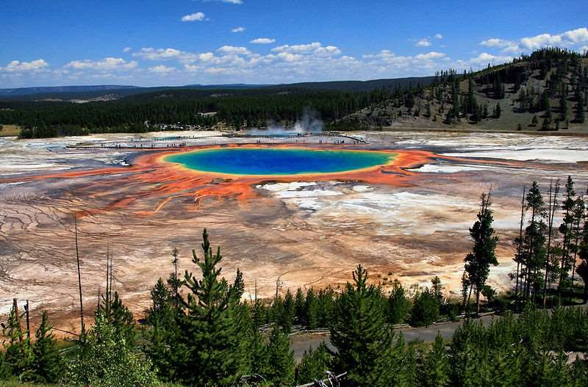
Grand Prismatic Spring and Midway Geyser Basin- Yellowstone National Park, USA
Source: Internet

Slide 14
CLASSIFICATION OF THERMOPHILES
1. Obligate thermophiles
Also known as extreme thermophiles.
Temperature range is 80-122⁰C.
Membranes and proteins are unusually stable at these extreme temperatures.
For this reason, most biological processes utilize thermophilic enzymes because of their ability to withstand intense heat.
Many of this group can resist radiation too.
Eg: Methanopyrus kandleri, can survive and reproduce at 122⁰C, Sulfolobus spp , Pyrococcus spp, Pyrodictium spp (optimum of 113⁰C)

Slide 15
Most of the members require elemental sulfur for growth.
Anaerobic members use sulfur as electron acceptor
instead of oxygen in cellular respiration.
Some are lithotrophs that oxidizes sulfur to sulfururic acid as an energy source.
Such organisms require a very low pH and hence
known as thermoacidophiles.
Inhabits regions associated with volcanic eruption viz; hot, sulfur rich, acidic regions such as hot springs, natural geysers, fumaroles etc .

Slide 16
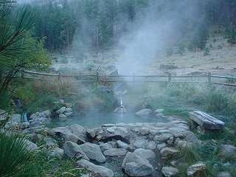
HABITATS OF EXTREMOPHILES
Hot spring situated in Atlanta, USA Courtsey:
http://www.idahohotsprings.com/destinations/atlanta/atlanta_hot_ springs_01.jpg

Slide 17
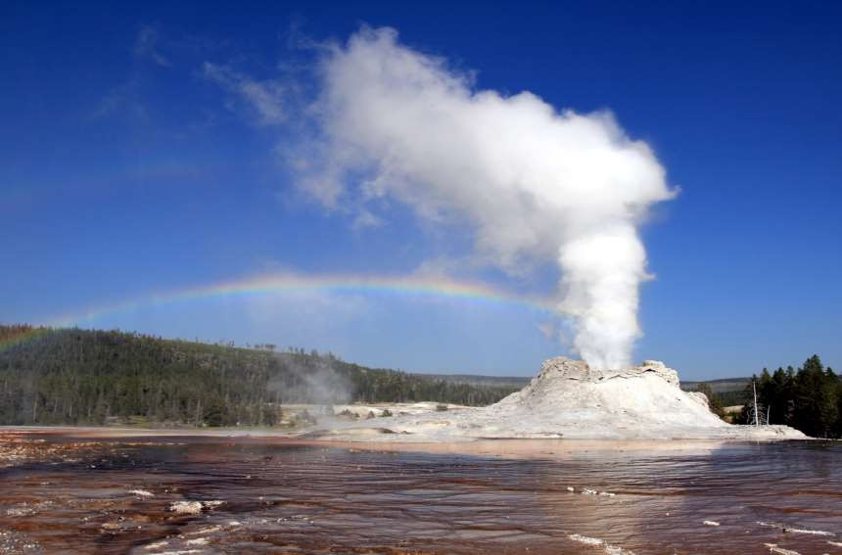
Castle Geyser, Yellowstone National Park, USA
Courtesy: http://upload.wikimedia.org/wikipedia/commons/4/49/Steam_Phase_eru ption_of_Castle_geyser_with_double_rainbow.jpg

Slide 18
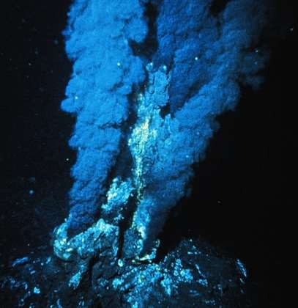
Black smoker at a mid-ocean ridge hydrothermal vent

Slide 19
Thermoacidophiles
Requires both high temperature and highly acidic environment for optimum growth.
Preferred temperature range is 70-80⁰C and have an optimum
pH range of 2-3.
All the organisms discovered belongs to the Domain Archae,
so far.
They can thrive in acidous and sulfur rich environments.
Instead of cell wall, possesses a unique membrane composed of tetraether lipoglycan, which gives the unusual stability for the bacteria.
Eg: Thermoplasma acidophilum and T.volcanium

Slide 20
Facultative Thermophiles
Rare group of organisms that can live both in higher temperature and normal temperature are referred to as facultative thermophiles.
These organisms can live at 20⁰C, and have an optimum of 50⁰C. Maximum temperature that they can survive is 60⁰C.
Eg: Bacillus flavothermus

Slide 21


Acidophiles or acidophilic organisms are those that thrive under highly acidic conditions (usually at pH 2.0 or below). These organisms can be found in different branches of the tree of life, including Archaea, Bacteria, and also Eukaryotes.
Archaea
Sulfolobes, an order in the Crenarchaeota branch of Archaea
Thermoplasmatales, an order in the Euryarchaeota branch of Archaea
Acidianus brierleyi, A. infernus, facultatively anaerobic thermoacidophilic archaebacteria
Haloarchaeum acidiphilum, acidophilic member of the Halobacteriacaeae
Metallosphaera sedula, thermoacidophilic
Bacteria
Acidobacterium, a phylum of Bacteria
Acidithiobacillales, an order of Proteobacteria e.g. A.ferrooxidans, A. thiooxidans
Thiobacillus prosperus, T. acidophilus, T. organovorus, T. cuprinus
Acetobacter aceti, a bacterium that produces acetic acid (vinegar) from the
oxidation of ethanol.
Alicyclobacillus, a genus of bacteria that can contaminate fruit juices.
]

Slide 22
ACIDOPHILES
Microorganisms that lives in highly acidic
environments are called as acidophiles.
The pH range is 1-5.
Some members that mainly found in the drainage of coal mines are able to oxidize sulfur into sulfuric acid.
Mechanism of action is that they have a proton pump machinery to eliminate protons from the cytoplasm of the cell to maintain low pH.
Eg: Pyrodictium, Picrophilus, Ferroplasma, Sulfolobus

Slide 23
Eukaryotes
Mucor racemosus
Urotricha
Dunaliella acidophila
Philodina roseola
Acidophiles are acid-loving microbes. Most natural environments on the earth are essentially neutral, having pH values between five and nine.
Acidophiles thrive in the rare habitats having a pH below five.
Highly acidic environments can result naturally from geochemical activities (such as the production of sulfurous gases in hydrothermal vents and some hot springs) and from the metabolic activities of certain acidophiles themselves.
Acidophiles are also found in the debris left over from coal mining.
Interestingly, acid-loving extremophiles cannot tolerate great acidity inside their cells, where it would destroy such important molecules as DNA.
They survive by keeping the acid out. But the defensive molecules that provide this protection, as well as others that come into contact with the environment, must be able to operate in extreme acidity. Indeed, extremozymes that are able to work at a pH below one--more acidic than even vinegar or stomach fluids--have been isolated from the cell wall and underlying cell membrane of some acidophiles.

Slide 24
· Most acidophile organisms have evolved extremely efficient mechanisms to pump protons out of the intracellular space in order to keep the cytoplasm at or near neutral pH.
Therefore, intracellular proteins do not need to develop acid stability through evolution. However, other acidophiles, such as Acetobacter aceti, have an acidified cytoplasm which forces nearly all proteins in the genome to evolve ACID stability.
For this reason, Acetobacter aceti has become a valuable resource for
understanding the mechanisms by which proteins can attain acid stability.
Studies of proteins adapted to low pH have revealed a few general mechanisms by which proteins can achieve acid stability.
· In most acid stable proteins (such as pepsin and the soxF over
protein from Sulpholobus acidocaldarius), there is an
abundance of acidic residues which minimizes low pH destabilization induced by a buildup of positive charge.

